Slide 1
MFIN 841: Investments, Spring 2017
Lecture 1: FinTech overview
Professor Ryan Riordan

Slide 2
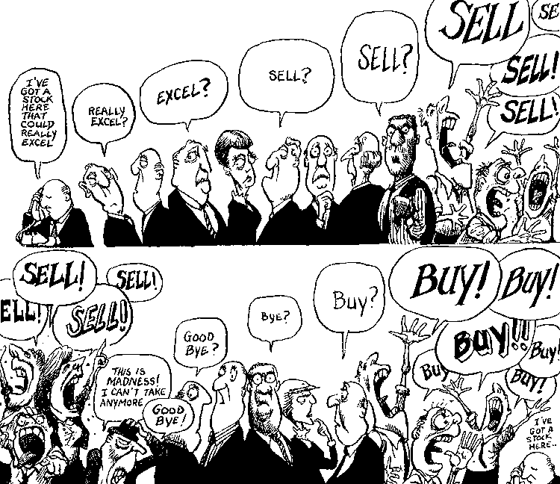

Slide 3
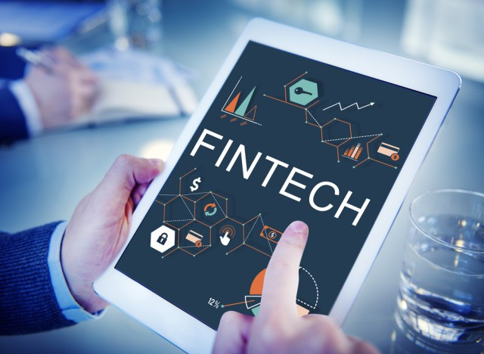
Welcome to FinTech!
What attracted you to this course?
What do you hope to learn?
Do you have future plans involving FinTech that expand beyond this course?
What is your definition of FinTech?
This is the first FinTech course (beta test) in a graduate program that we know of in Canada!
You are first to experience this exciting journey!

Slide 4
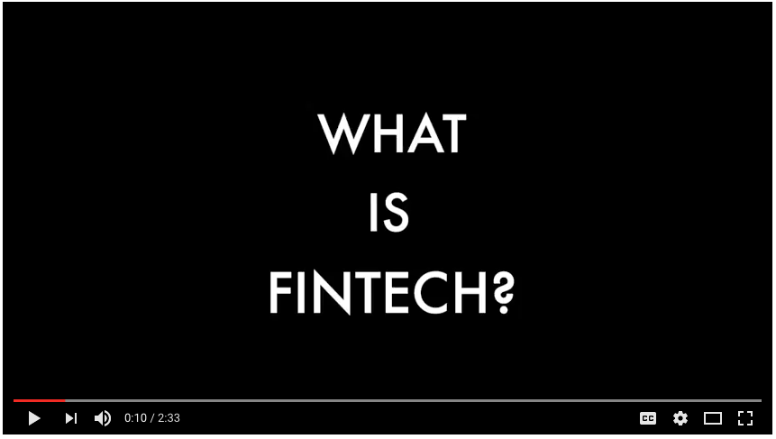
What is FinTech?

Slide 5

Course Goals
The purpose of this course is to examine emerging advances in all aspects of innovative financial technologies (FinTech), including:
How information is transmitted
How trading takes place today
New currency and payment systems
Humans interacting with machines
Borrowing and lending
What does the future hold?

Slide 6
The instructor
Dr. Ryan Riordan,
Associate Professor & Distinguished Faculty Fellow of Finance
PhD Dissertation Topic:
The Economics of Algorithmic Trading
Academic Positions:
Queen’s School of Business
University of Ontario Institute of Technology
Karlsruhe Institute of Technology
University of California at Berkeley
Some Research Awards:
The Monieson Centre for Business Research: Disruptive Technology and Financial Innovation https://smith.queensu.ca/centres/monieson/disruptive_technology_financial_innovation.php
Council for Research and Promotion of Young Scientists - 3 year grant (660,000 Euro)
Social Sciences and Humanities Research Council ($80,000)
To see my research, visit my webpage: www.ryanriordan.ca or my Google Scholar page.

Slide 7
This lecture – Overview of FinTech
Block chain and Bitcoin
Robo-Advisors
Peer to Peer Lending & Investing
Crowdfunding
Social Media
Algorithmic & High Frequency Trading
The Financial System

Slide 8
The Financial System
Intermediaries
Destination of Funds
Source of Funds
Lenders
Banks
Platforms
Borrowers
Investors
Financial markets
Financial Institutions
Investees
Payments System
Retail
Customers & Clients

Slide 9
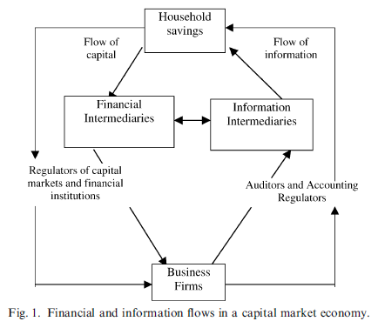
The Accounting System: Flow of Funds and Information
Healy & Palepu, JAE 2001

Slide 10
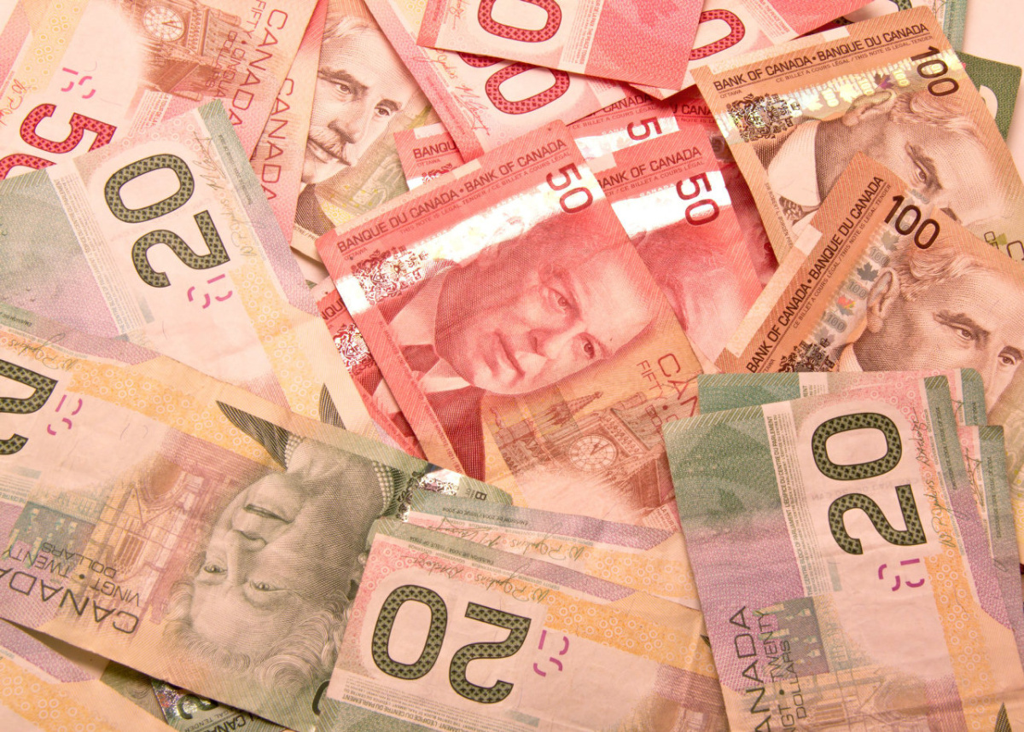
Savings = Investment
Capital originates from wealth creation, controlled by households
Returns on capital earned through lending, investing excess funds
Excess funds (savings) are residual, after consumption

Slide 11
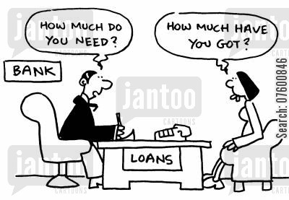
Financial Intermediaries
Match savers’ excess funds with borrowers and investees who require capital
Vet borrowers for creditworthiness and investees for prospects
Profit = income from borrowers and investees – interest paid to savers

Slide 12
Destinations of Funds
Borrowers and investees use savers’ excess capital to finance investment projects or consumption
Under a borrowing arrangement when the borrower is a firm, capital is safer and must be repaid prior to shareholder distributions
Under an equity investment arrangement, capital stake is at higher risk, but with chance of increase in value
Under a personal borrowing arrangement, risk of capital depends on individual’s ability or willingness to repay the loan in the future

Slide 13
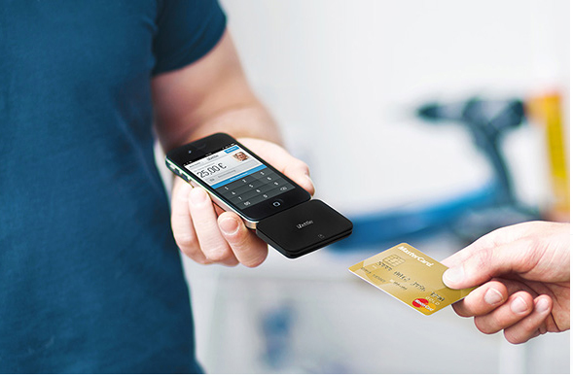
The Payment System
Consumers exchange currency or the promise of currency for goods or services
When cash is not directly being exchanged, an alternative payment system is necessary
Cheques, bank drafts, credit/debit cards
Some payment systems provide convenience and security in exchange for fees or commission on total funds transferred
Fees collected from payers, receivers, or both
www.softqubes.com

Slide 14
Disruptions to Financial System
New entities
Financial Technology (Fintech)
New payment systems
Digital wallets
New intermediaries
Crowdfunding
Destabilize traditional links in the financial system
Industry comprised of technology firms focused on improving efficiency in financial system
Mobile payments (e.g. Square, Inc.), Paypal, Apple Pay
Bitcoin
ETFs
micro-lending
new stock exchanges (e.g. IEX),
Robot financial advisors

Slide 15
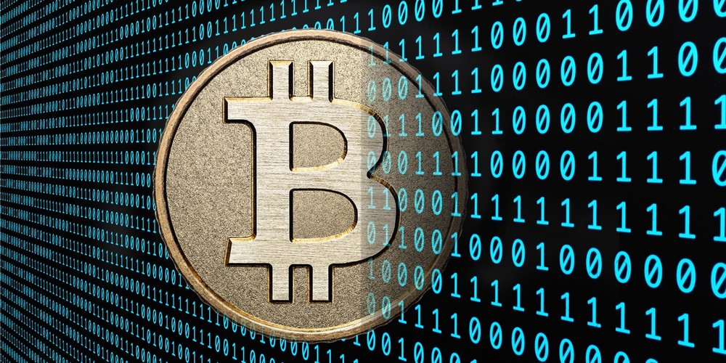
Block Chain and Bit Coin
www.ctl.io

Slide 16
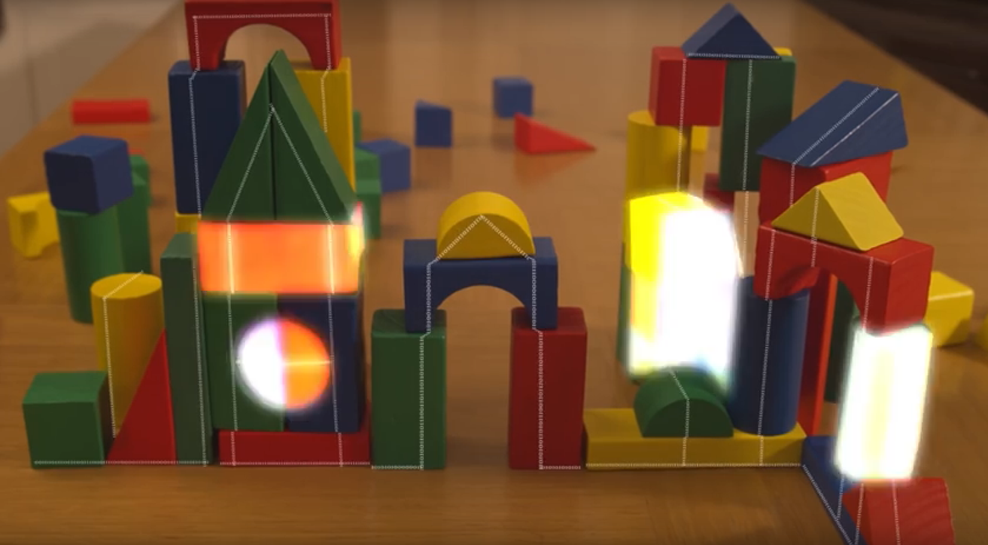
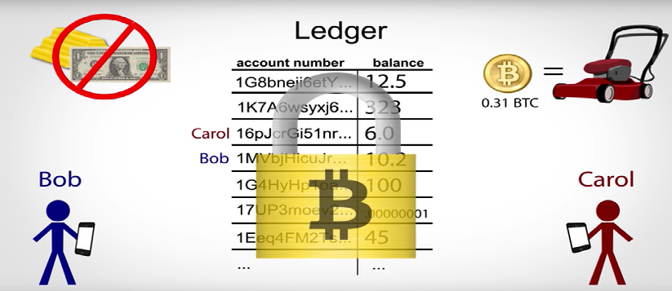
Block chain & bit coin
General video describing block chain:
https://www.youtube.com/watch?v=4sm5LNqL5j0
More details of how bit coin works: https://www.youtube.com/watch?annotation_id=annotation_3929731879&feature=iv&src_vid=l9jOJk30eQs&v=t5JGQXCTe3c
This is an excellent 22-minute video; watch this video at home!
https://www.youtube.com/watch?v=Lx9zgZCMqXE

Slide 17
Bitcoin (2009-present)
Digital Ledger
Digital “ledger”
Digital signature
Private keys required to generate digital signatures for each transaction
Decentralized
Network of users
payment system
Digital wallet
No individual user owns all the records
Miners
Confirm accuracy of transactions
Small bit coin reward!
Inflation
New currency rewarded to miners
No more “new money” after 2040

Slide 18
Bitcoin (2009-present)
Traditional banking system
Bank controls ledger
Only individual’s transactions can be viewed
Trust in bank required to maintain ledger
Bitcoin system
No centralized entity controls ledger
ALL transactions in history of Bitcoin can be viewed
No trust in any entity required

Slide 19
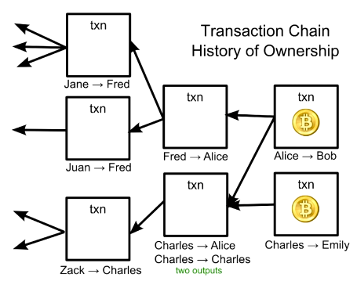
Transaction chain
Tracks history of Bitcoin transactions
Replaces need for current “ledger” – references to past Bitcoins received and spent determine Bitcoins available
Shows that the owner of Bitcoins has past incoming transactions adding up to amount being transferred out

Slide 20
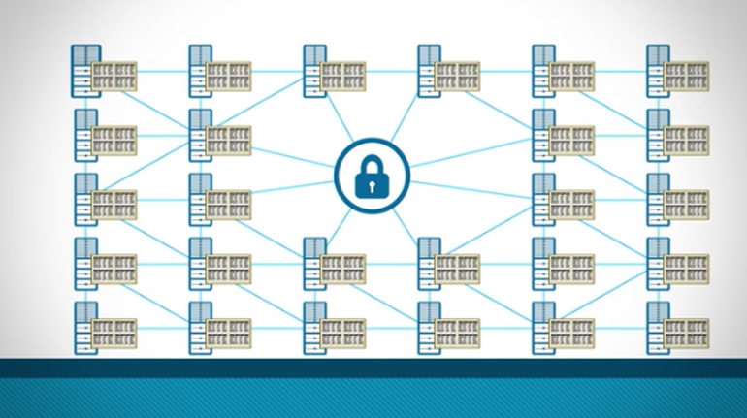
Block chain architecture
Groups transactions occurring at the “same” time and arranges them in blocks – represents timing of past transactions
Blocks reference previous blocks
Block chain is public with decentralised agreement over ordering of blocks determined by Bitcoin mining activity
Arguably more important and potentially useful than Bitcoin

Slide 21

Robo Advisors
www.cnb.com

Slide 22

What are robo advisors?
“Robo advisors manage portfolios automatically, with their decisions driven by software.¹”
https://www.youtube.com/watch?v=uPAGQJssHcA
1. http://www.forbes.com/sites/rogergershman/2015/04/30/robo-advisors-versus-financial-advisors-which-is-best-for-you/#edf19d11470c
www.forbes.com

Slide 23
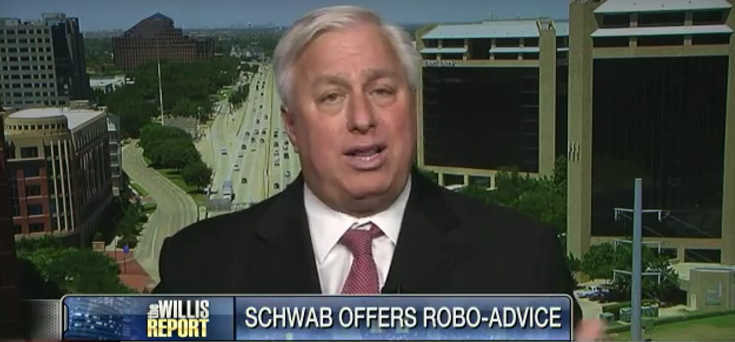

Is it good or is it bad?
Where is the value?
https://www.youtube.com/watch?v=B6fQboyG8-0
Are robo-advisors always good?
https://www.youtube.com/watch?v=YycdAwu0320
What do you think?
Which view has more merit?
Are there other views?

Slide 24
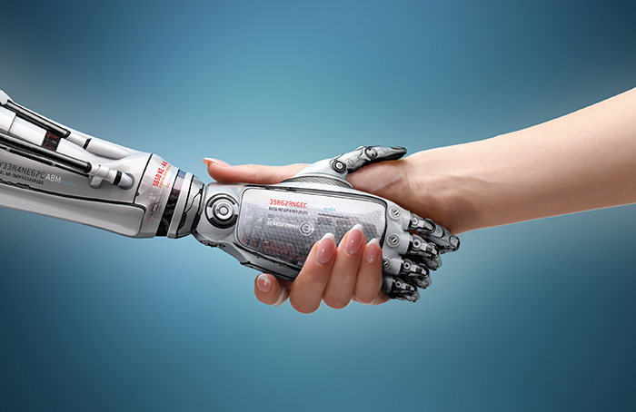
Demographics and future
Is it only millennials?
A study by E*Trade Streetwise shows that the majority of age groups 25-34, 35-55, and 55+ all prefer at least some form of digital advice.
Is it possible to combine human with robo advisors?
What does the future hold?
www.forbes.com
http://www.wealthprofessional.ca

Slide 25

Peer to peer (P2P) lending and investing

Slide 26
How does it affect the financial system?
Funds
suppliers
Deposits
Financial intermediaries
Loans
Funds demanders
Funds
suppliers
Financial intermediaries
Funds demanders

Slide 27

P2P definition
“P2P lending matches borrowers with investors. In theory, it takes out financial institutions that have played the middleman, thus decreasing costs for borrowers and increasing returns for investors. In reality, the middleman has simply changed from banks to P2P sites such as Lending Club and Prosper.” (Rob Berger, www.forbes.com)

Slide 28
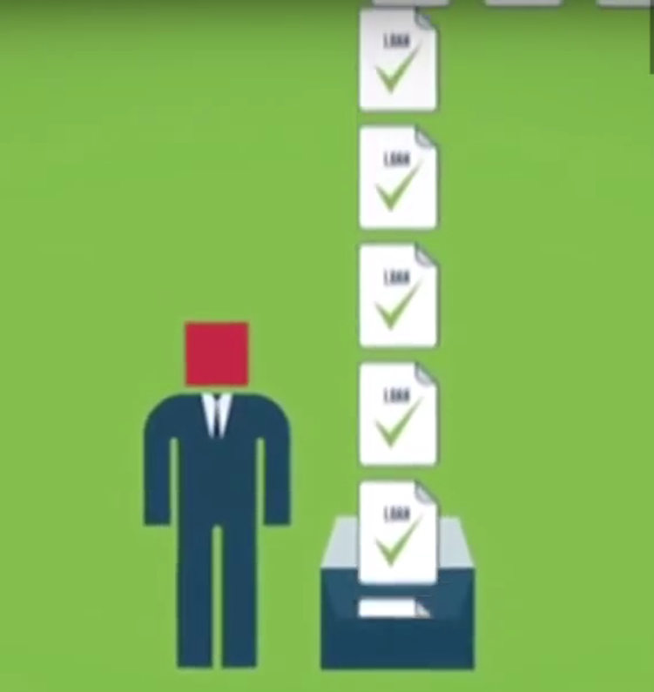
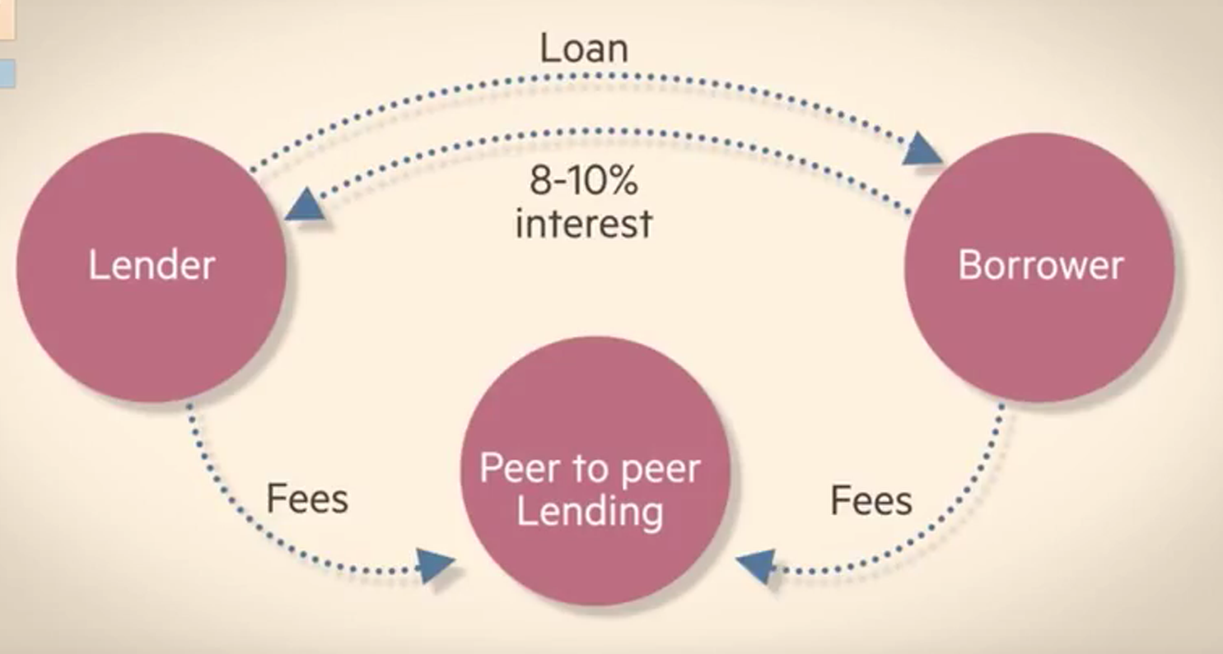
Growth of industry
https://www.youtube.com/watch?v=48kFuTtXexk
https://www.youtube.com/watch?v=C_c9Hs3wGv4

Slide 29
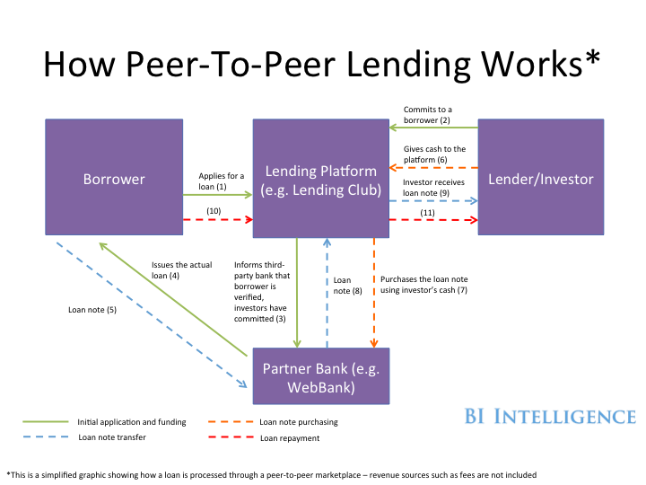
http://static5.businessinsider.com

Slide 30

Comic relief
What does Shakespeare think about borrowing and lending?
The reality is, you are always a borrower, lender, or both!

Slide 31
Peer to peer lending
Pros
Quicker!
Better rates
No middle man!
Cons
What else?
Credit risk
No formal institution (no peace of mind)

Slide 32
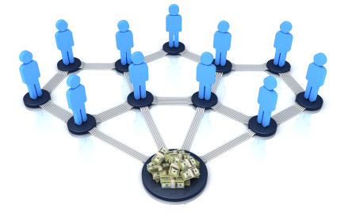
Crowdfunding
https://avbtraining.mwweb.me

Slide 33
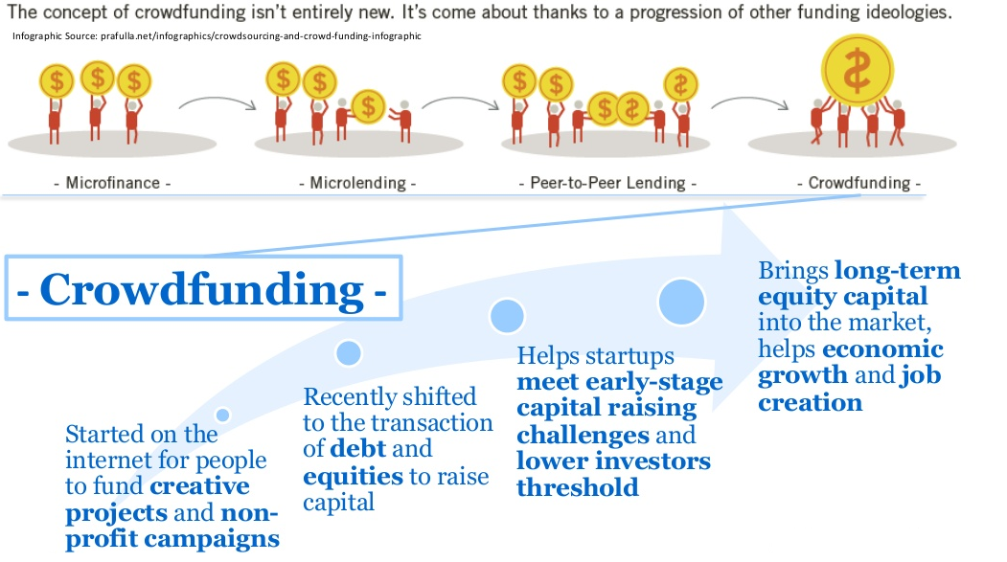
Crowdfunding - overview
http://www.slideshare.net/smallbusinessmajority/crowdfunding-webinar-30323581

Slide 34
The need for crowdfunding
Types of Crowdfunding financing:
Equity Financing
Debt Financing
Financing for gifts or early access to products!
Fills a gap in the Venture Capital Industry
Entrepreneurs can’t easily access capital
VC terms are very aggressive to entrepreneurs
Crowdfunding seems to address this gap

Slide 35
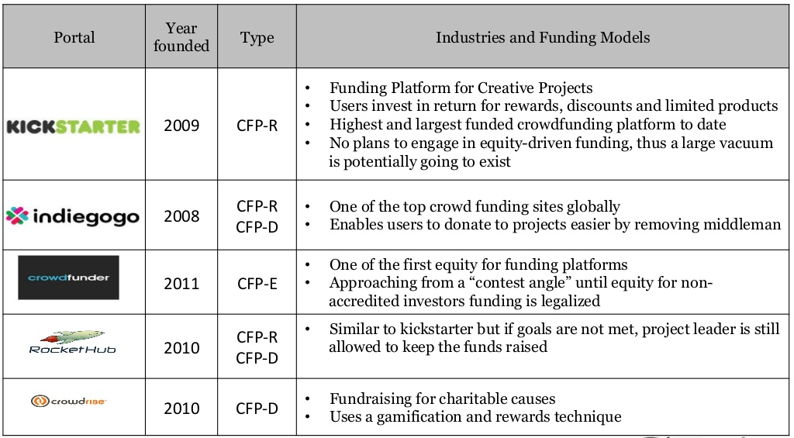
Crowdfunding platforms
http://www.slideshare.net/smallbusinessmajority/crowdfunding-webinar-30323581

Slide 36


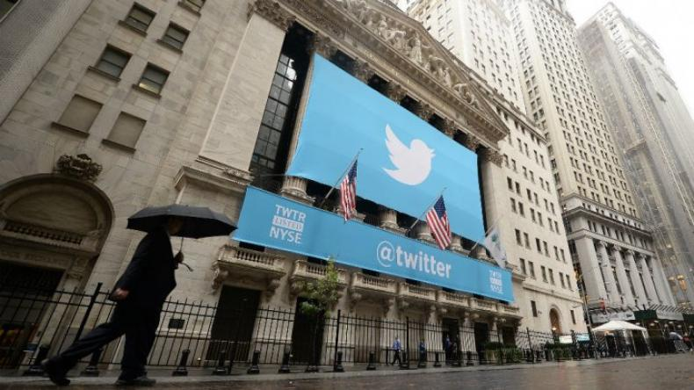
SOCIAL MEDIA

Slide 37
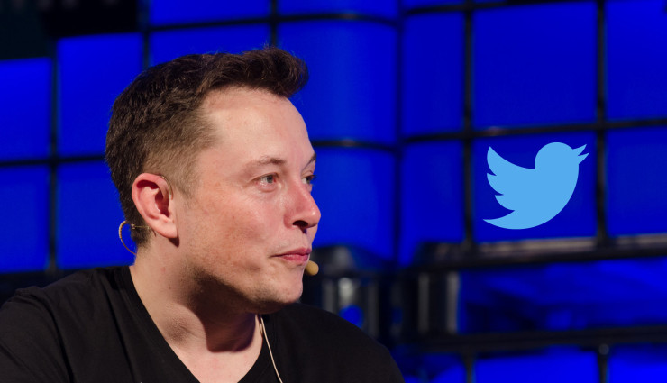
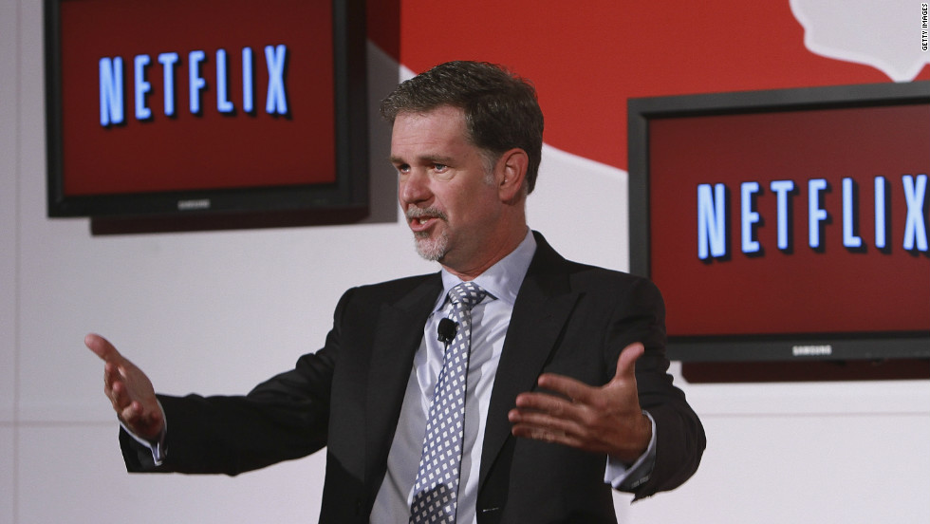
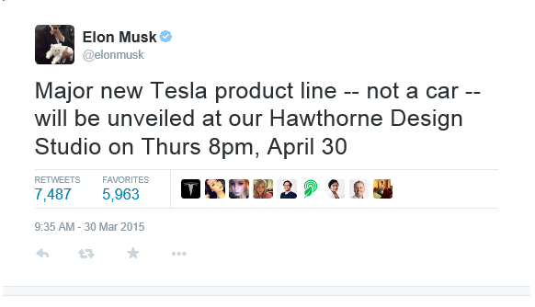
Does Social Media matter?
“Congratulations to Ted Sarandos and his amazing licensing team. Netflix monthly viewing exceeded 1 billion hours for the first time ever in June…Ted, we need even more!”

Slide 38
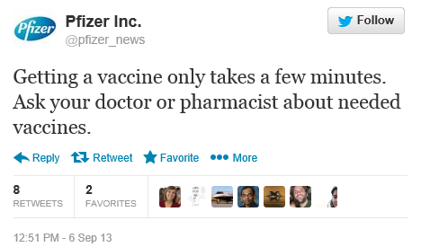
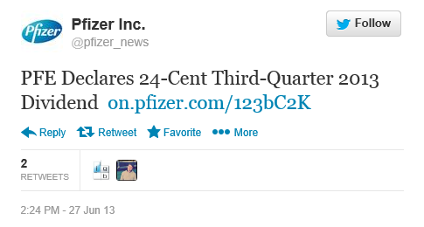
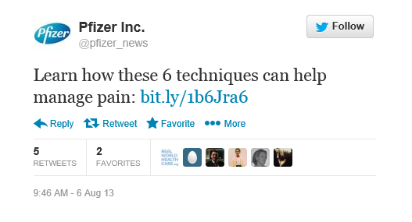
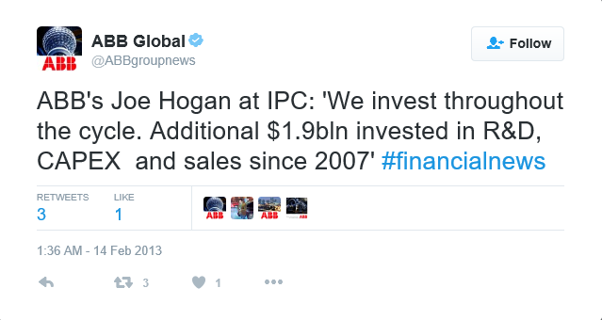
Twitter: Types of Tweets
1. General interest: represents the majority of tweets
2. Financial tweets: targeting investors or potential investors, usually a (much) smaller number of tweets

Slide 39
Twitter in the Finance Industry
Financial Analysts use Twitter to extract useful info
Investor Relations departments use Twitter
Twitter ETF

Slide 40

Algorithmic & High Frequency Trading

Slide 41
Investors and Technology
Algorithmic Trading
High-Frequency Trading
Hedge Funds
Banks
Algorithmic Agency
Brokers
“The use of computer algorithms to manage the trading process.“
(Hendershott et al. 2011)
Types of Algorithmic Trading
Participants
(Hasbrouck and Saar 2011)
Other Intermediaries
Goals
(Hasbrouck and Saar 2011)
Profit
Profit Maximization
Transaction Cost Minimization
Profit and
Short-Term Information
Liquidity and
Long-Term Information

Slide 42
IT has changed the traditional trading process
70s
80s
late 90s/ 2000
today
Investor
Investor
Investor
Investor
$
$
$
$
Algo
Phone/ Fax
Phone/ Fax
OMS
OMS/ EMS/ AMS
FIX
Phone/ Fax
FIX
Phone/ Fax
Broker
Broker
Broker
Broker
Sales Trader
Sales Trader
Sales Trader
Algo
Algo
SORT*
DMA
Order
Order
Order
Order
Dark Pool
Exchange
Exchange
ECN/ MTF
Exchange
ECN/ MTF
Exchange

Slide 43
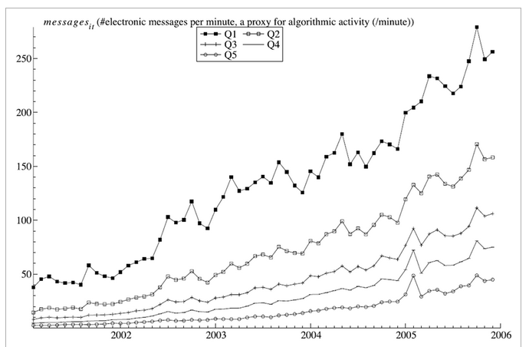
Has Algorithmic Trading Increased?

Slide 44
This lecture
Block chain and bit coin
Robot Advisors
Peer to Peer Lending & investing
Crowdfunding
Social Media
Algorithmic & High Frequency Trading

